Slide 1

Discriminating Between Fast- and
Slow-moving Zombies Using Proton MRS
1
2
¹ John D. Port, M.D., Ph.D., ² Emily T. Wood, B.S., ² Laura M. Roland, M.D.

Slide 2

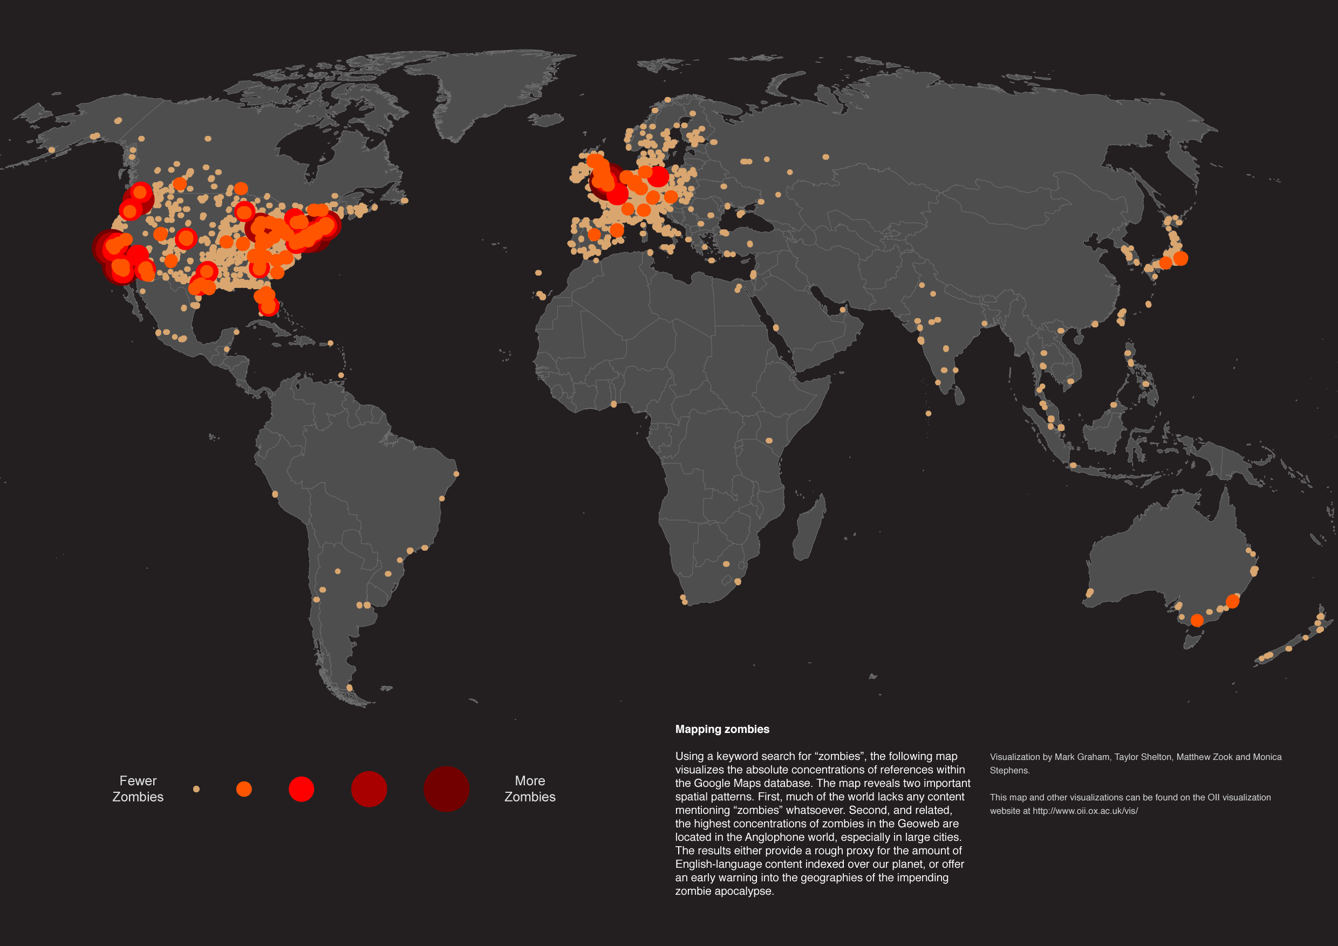
Introduction
Zombie apocalypse is a major public health issue
The WHO estimates that 2-3% of the world’s population converts to zombies each year
Two undead conversion types
  Slow Moving Zombies (SMZ)
    Life threatening drive to consume flesh
    Slow attack speeds
  Fast Moving Zombies (FMZ)
    Extremely dangerous
    Attack speeds surpass live human reaction times
    Greater metabolic requirement (even hungrier)

Slide 3


Introduction
To date, no studies have been able to distinguish between fast- and slow-moving zombies
We hypothesize that fast-moving zombies (FMZ) have decreased brain lactate in the motor cortex and frontal lobes as compared to slow-moving zombies (SMZ) due to greater aerobic metabolism and faster reaction times
Slow-Moving Zombies
Fast-Moving Zombie

Slide 4
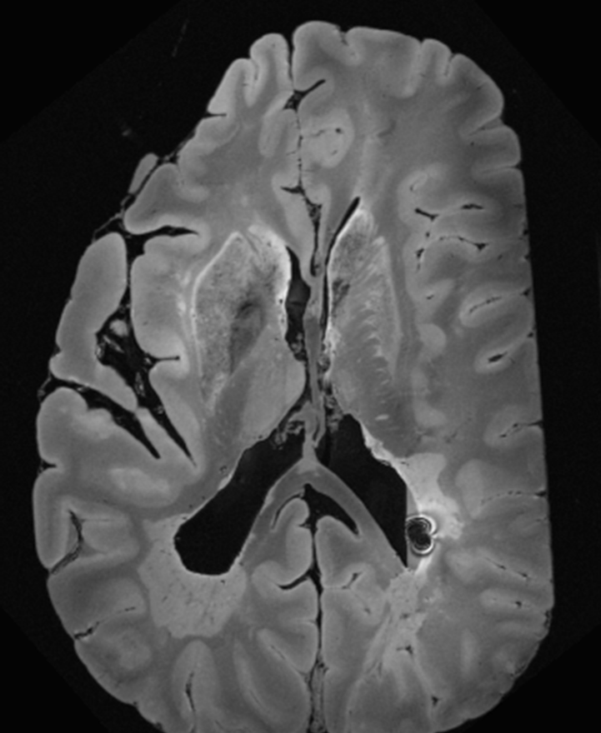
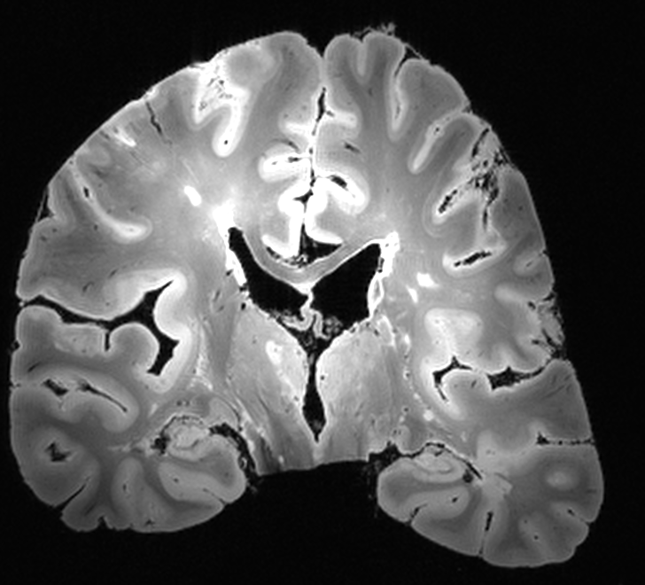
Methods
RDLPFC
RMC
Recruited 40 zombies from a local cemetery
Diagnosis confirmed using Structured Clinical Interview for Zombies (SCIZ)
Zombie subtype (fast vs slow) determined by Neck Bite Phantom Test (NBPT)
MRI/MRS performed (GE 3T DV750 scanner)
  Anatomical images (MPRAGE) for localization, CSF/air correction
  3 PRESS voxels (2x2x2 cm, TR=2000, TE=35, NEX=256) using macromolecular nulling
  Voxels located in right dorsolateral prefrontal cortex (RDLPFC), right motor cortex (RMC), and right occipital cortex (ROC, intended as a control area)
Data analyzed with LCModel using a basis set provided by the vendor
ROC

Slide 5
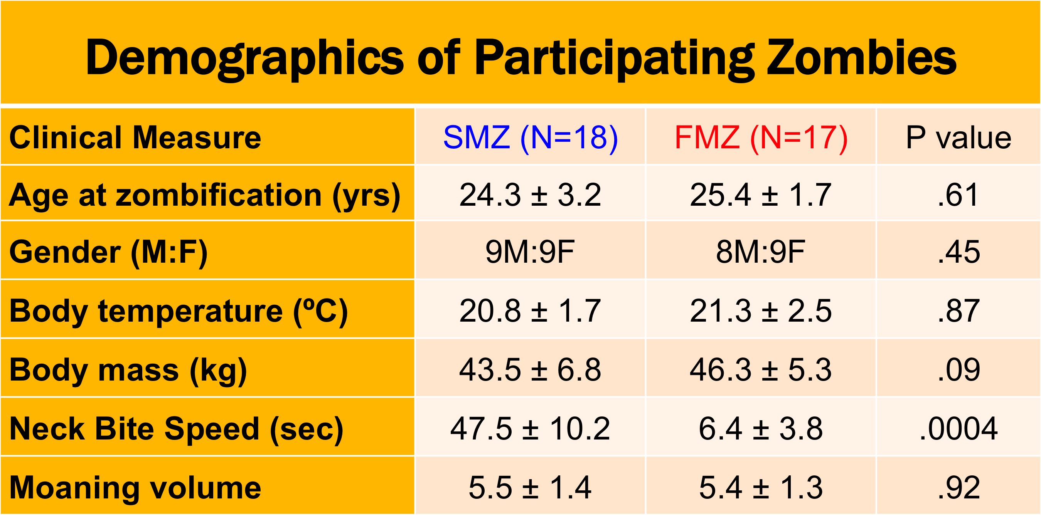
Results
Recruited 40 subjects
5 subjects dropped out due to inability to hold still during the scan
Two groups indistinguishable by all measures except for neck bite speed

Slide 6
Results
Neck bite phantom test clearly showed two different groups of zombies based on bite times
We defined FMZ as having bite times less 24 seconds, and SMZ as having bite times more than 24 seconds

Slide 7
Results
Unidentified peak
Fast Moving Zombie
Representative LCModel analysis of RDLPFC voxels from a fast- and slow-moving zombie
Spectra are similar
Large lactate peak for both types of zombies
Also discovered a peak at 2.93 ppm that LCModel did not fit
Further work needed to determine the compound generating that peak
Unidentified peak
Slow Moving Zombie

Slide 8
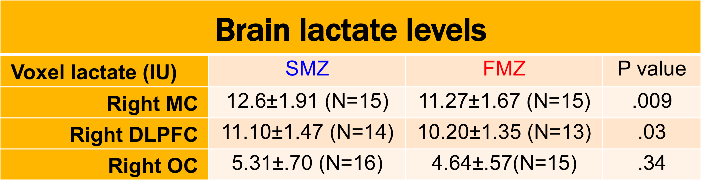
Results
Quantitative analysis of brain lactate in the RMC and RDLPFC
Significantly less lactate in the brain sof FMZ in the RDLPFC and RMC
No significant lactate different in ROC as expected
Large overlap between lactate levels in FMZ, SMZ
As such, lactate levels probably are not a good biomarker for distinguishing between FMZ, SMZ
RMC Lactate
RDLPFC Lactate

Slide 9

Conclusions
First study to perform MRS in zombies
Found significantly decreased lactate in RMC and RDLPFC of FMZ relative to SMZ, supporting the aerobic metabolism theory for animated-subtype (fast-moving) zombies
Found a new unidentified peak in the brains of both FMZ and SMZ (perhaps a methylated byproduct of the infection that reanimates the corpse?)
Lactate probably not useful as a biomarker to distinguish between FMZ and SMZ
Thank you ISMRM, especially Derek Jones & Roberta Kravitz

