Slide 1
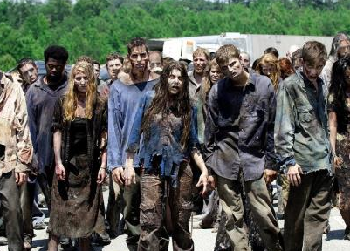
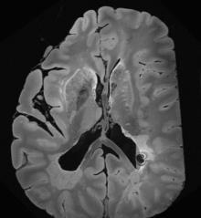
Discriminating Between Fast- and
Slow-moving Zombies Using Proton MRS
John D. Port, M.D., Ph.D., Emily T. Wood, B.S., Laura M. Roland, M.D.

