Slide 1

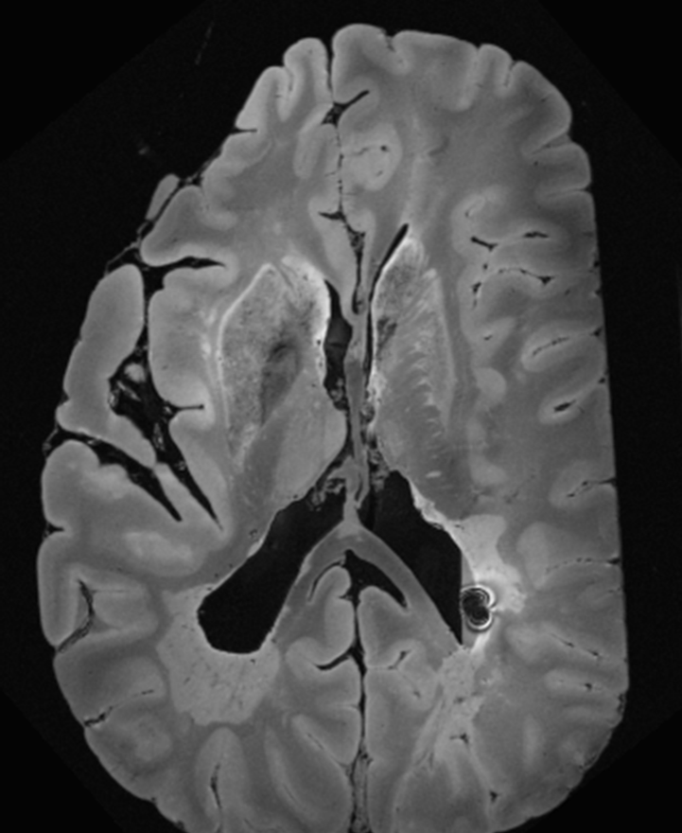
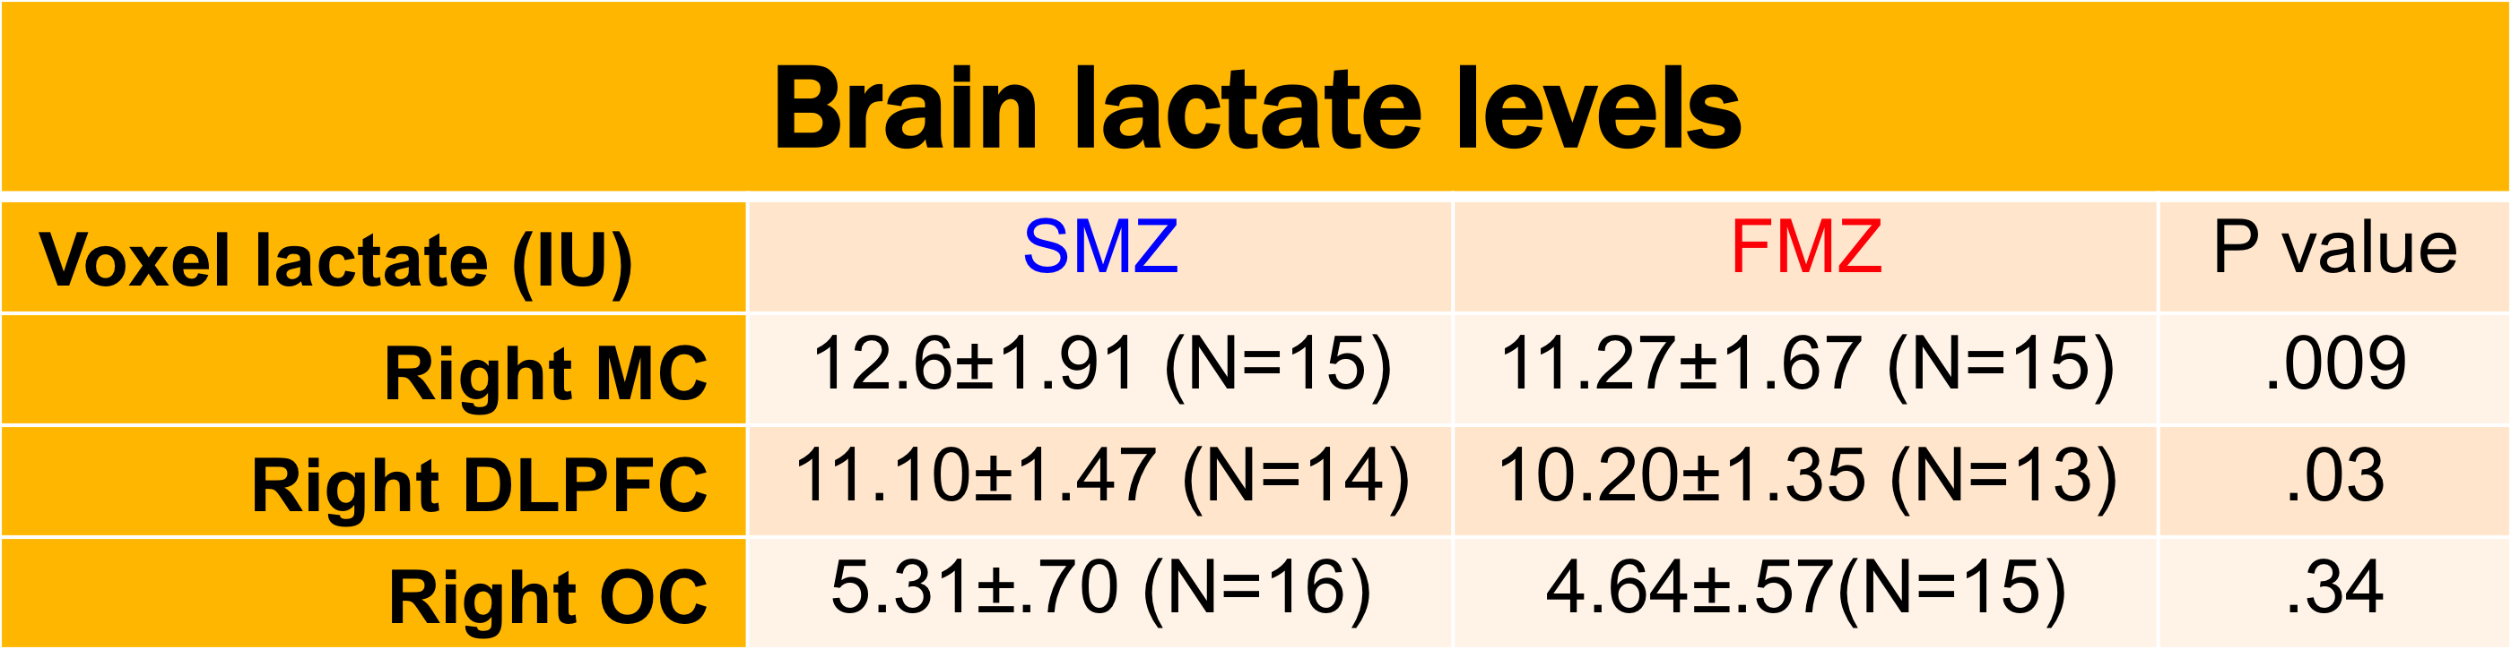
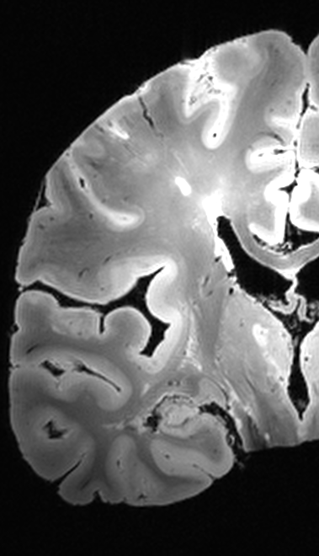
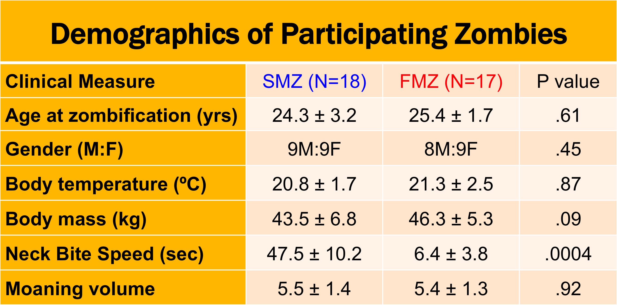
Discriminating Between Fast- and Slow- moving Zombies Using Proton MRS
1
2
¹ John D. Port, M.D., Ph.D., ² Emily T. Wood, B.S., ² Laura M. Roland, M.D.
Introduction
Zombie apocalypse is a major public health issue.
Slow Moving Zombies (SMZ)
  Life threatening drive to consume flesh, slow attack speeds
Fast Moving Zombies (FMZ)
  Extremely dangerous; attack speeds surpass live human reaction times
To date, no studies have been able to distinguish between FMZ and SMZ
We hypothesize that FMZ have decreased brain lactate in the motor cortex and frontal lobes compared to SMZ due to greater aerobic metabolism and faster reaction times
MRI/MRS performed (GE 3T DV750 scanner)
  Anatomical images (MPRAGE) for localization, CSF/air correction
  3 PRESS voxels (2x2x2 cm, TR=2000, TE=35, NEX=256) using macromolecular nulling
RMC Lactate
RDLPFC Lactate
Results
Conclusions
First study to perform MRS in zombies
Found significantly decreased lactate in RMC and RDLPFC of FMZ relative to SMZ, supporting the aerobic metabolism theory for animated-subtype zombies
Found a new unidentified peak in the brains of both FMZ and SMZ (perhaps a methylated byproduct of the infection that reanimates the corpse?)
Exemplary Spectra (LC Model fit)
Unidentified peaks
Methods
Recruited 40 zombies from a local cemetery
Diagnosis confirmed using Structured Clinical Interview for Zombies (SCIZ)
Zombie subtype (fast vs slow) determined by Neck Bite Phantom Test (NBPT)
Fast Moving Zombie
Slow Moving Zombie

