Slide 1


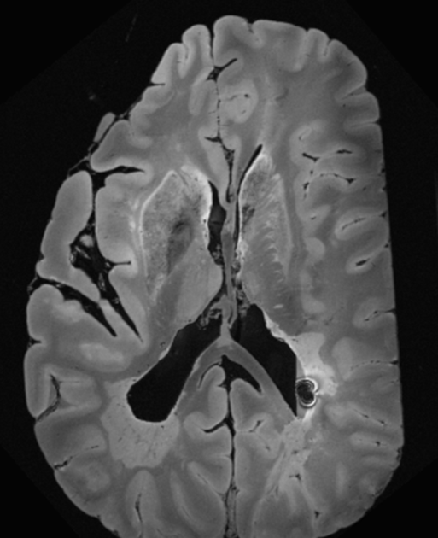
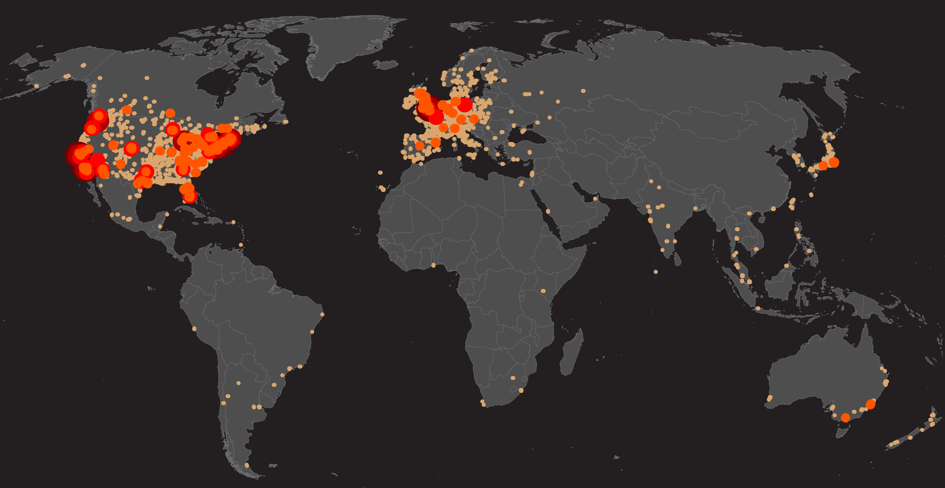
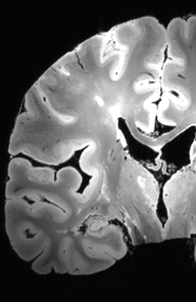
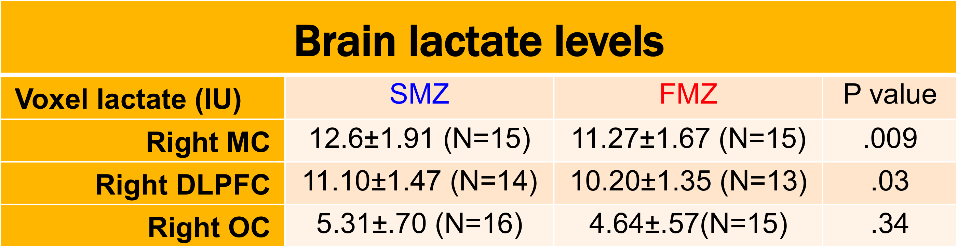
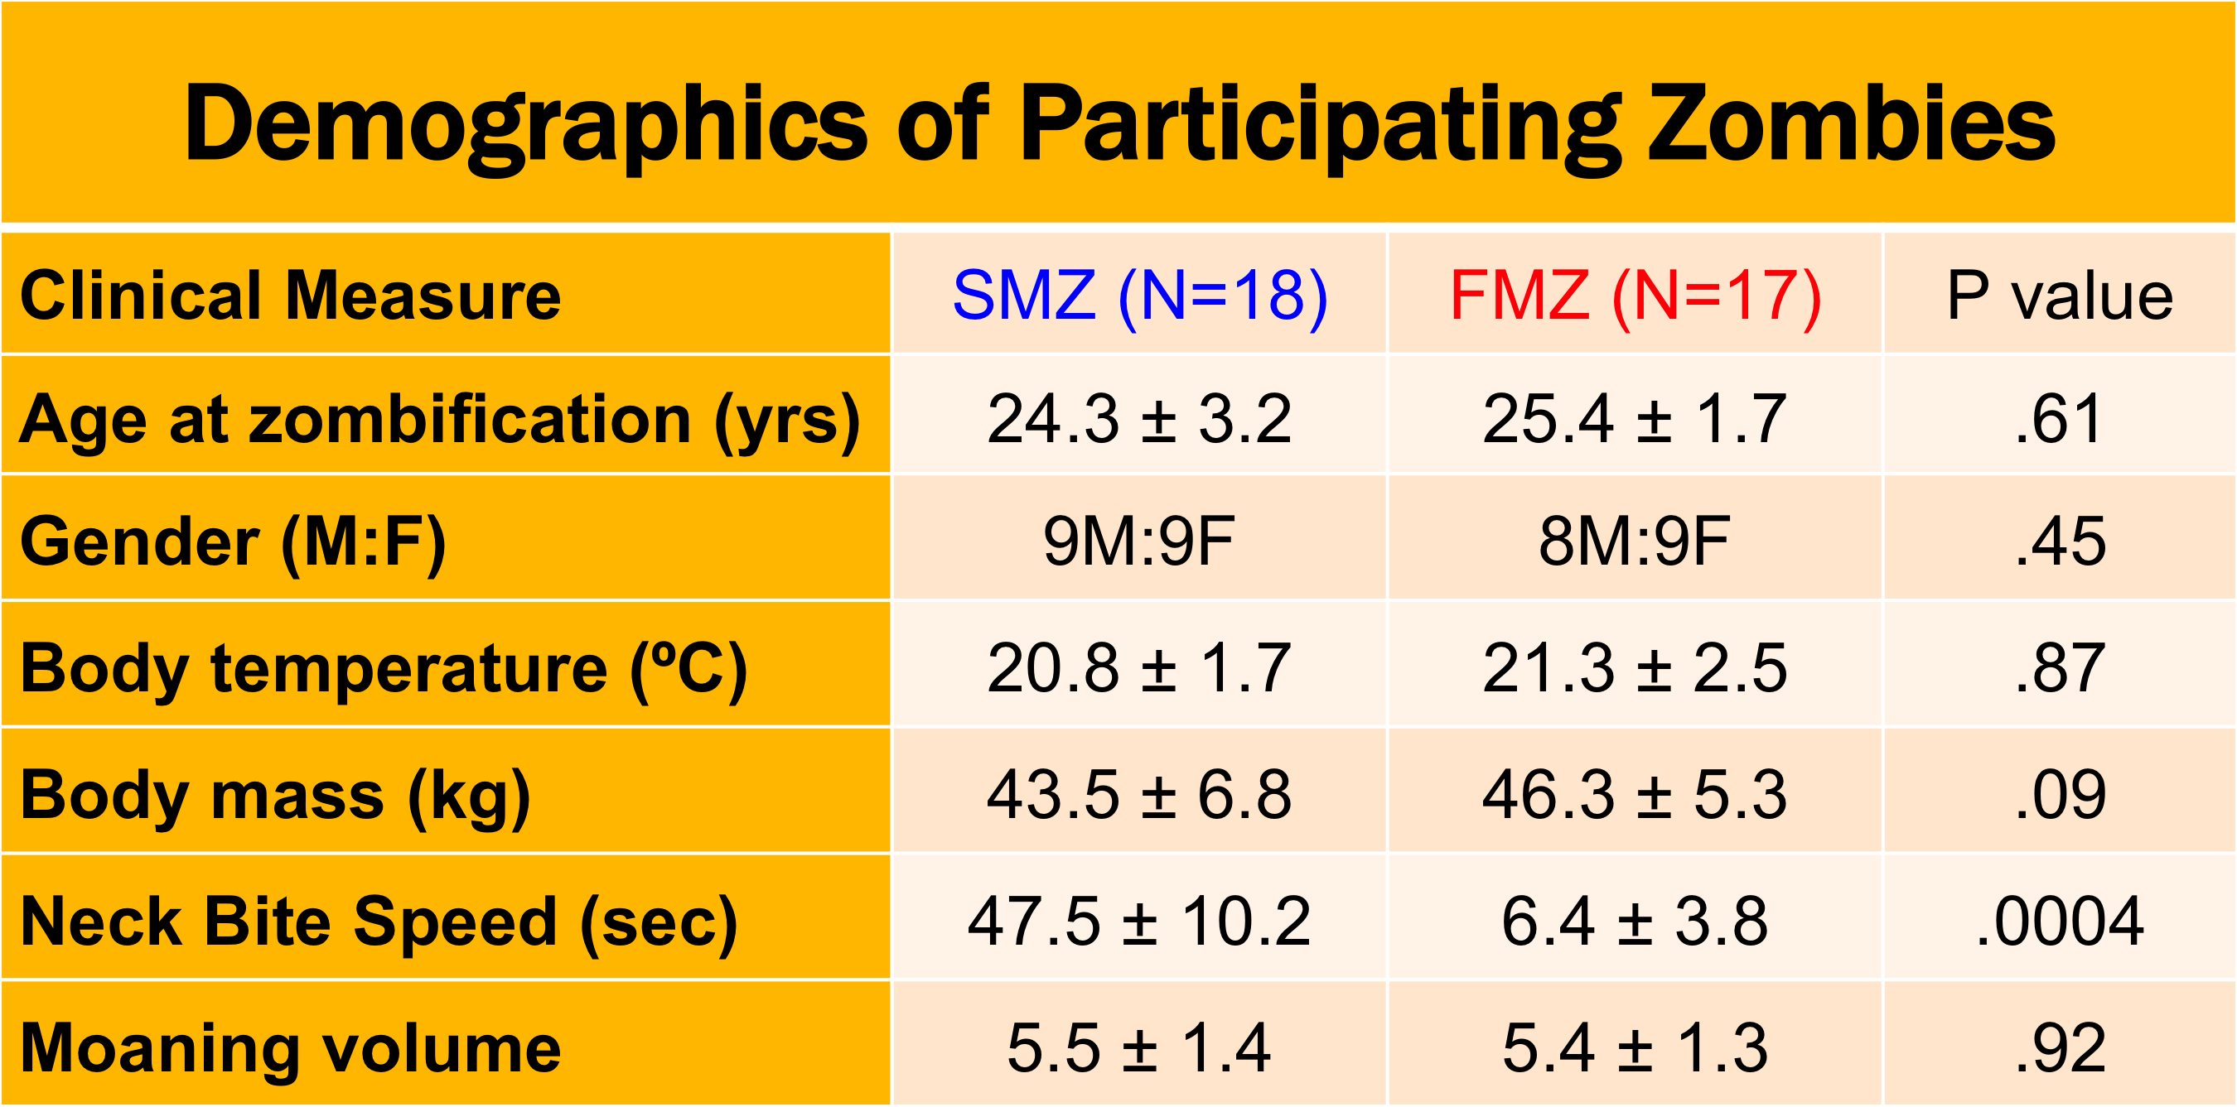

Discriminating Between Fast- and Slow-moving Zombies Using Proton MRS
Poster # 00ZZ
1
2
¹ John D. Port, M.D., Ph.D., ² Emily T. Wood, B.S., ² Laura M. Rowland, Ph.D.
Introduction
Methods
Recruited 40 zombies from a local cemetery
Diagnosis confirmed using Structured Clinical Interview for Zombies (SCIZ)
Zombie subtype (fast vs slow) determined by Neck Bite Phantom Test (NBPT)
MRI/MRS performed (GE 3T DV750 scanner)
Anatomical images (MPRAGE) for localization, CSF/air correction
3 PRESS voxels (2x2x2 cm, TR=2000, TE=35, NEX=256) using macromolecular nulling
Exemplary Spectra (LC Model fit)
Undead Conversion
Types:
Slow Moving Zombies (SMZ)
Life threatening drive to consume flesh
Fast Moving Zombies (FMZ)
Extremely dangerous;
Attack speeds surpass live human reaction times;
Greater metabolic requirement
(even hungrier)
Unidentified peaks
Results
Zombie apocalypse is a major public health issue.
WHO est. 2-3% of world pop converts
per year.
Fast Moving Zombie
Slow Moving Zombie
RMC Lactate
RDLPFC Lactate
Motivation
To date, no studies have been able to distinguish between fast- and slow-moving zombies
We hypothesize that fast-moving zombies (FMZ) have decreased brain lactate in the motor cortex and frontal lobes as compared to slow-moving zombies (SMZ) due to greater aerobic metabolism and faster reaction times.
Conclusions
First study to perform MRS in zombies
Found significantly decreased lactate in RMC and RDLPFC of FMZ relative to SMZ, supporting the aerobic metabolism theory for animated-subtype zombies
Found a new unidentified peak in the brains of both FMZ and SMZ (perhaps a methylated byproduct of the infection that reanimates the corpse?)
Thank you ISMRM, especially Derek Jones & Roberta Kravitz

